Slide 1

Green Pace
Security Policy Presentation
Developer: Marissa Lanza
Course: CS 405 – Secure Coding (CS-405-15275-M01)
Term: 2025 C-4 (Jun–Aug)
Assignment: Project Two – Security Policy Presentation
Organization: Green Pace
Developer: Marissa Lanza
Date: August 13, 2025

Slide 2

OVERVIEW: DEFENSE IN DEPTH
Why now: Standardize secure-by-default practices as the team scales.
Approach: Defense-in-depth + assume-breach to reduce attack surface.
Scope: People, process, and tech across network, host, app, data, and identity.
Enforcement: 10 principles → 10 coding standards + CI automation (SAST/SCA/DAST, unit tests).
Outcome: Consistent, auditable controls; faster detection/response; lower risk.

Slide 3
THREATS MATRIX
How to read the matrix: Risk = Likelihood × Impact.
Risk bands: 16–25 = Priority, 12–15 = Likely/Moderate, ≤8 = Low.
Top risks (fix first): STD-001 Injection (20), STD-008 Secrets management (20),
STD-009 Supply chain (16), STD-002/003 Auth & crypto misuse (15), STD-006 Memory safety (15).
Likely/moderate: STD-004 Error info leaks, STD-005 Logging gaps,
STD-007 Race/TOCTOU, STD-010 Build/deploy hardening (all 12).
Low priority: Cosmetic logs/messages, minor style/lint, documentation drift with compensating controls.
Unlikely: Break of TLS 1.3/AES-GCM, KMS/HSM compromise, signed-release tamper post-signature,
all mitigations bypassed simultaneously.
Remediation order: 001 → 008 → 009 → 002/003/006 → 004/005/007 → 010.
STD-004 – Error/exception info leaks (L4×I3=12) STD-005 – Logging exposure/gaps (L3×I4=12) STD-007 – Race/TOCTOU in file/IO (L3×I4=12) STD-010 – Build/deploy hardening gaps (L3×I4=12) | STD-001 – Injection (SQL/command/XSS) (L5×I4=20) STD-008 – Secrets mgmt failures (L4×I5=20) STD-009 – Supply-chain compromise (L4×I4=16) STD-002 – Auth/session weaknesses (L3×I5=15) STD-003 – Crypto misuse/weak modes (L3×I5=15) STD-006 – Memory safety defects (L3×I5=15)
Documentation drift; style/lint issues (no security impact) Minor log level inconsistencies (no PII) Cosmetic error messages (no sensitive data) Low-severity dev-only findings with compensating controls | Break of TLS 1.3 / AES-GCM; KMS/HSM compromise Signed release tampered post-signature (with attestations) Compiler mitigations (CFG/Spectre) all bypassed simultaneously MFA + Argon2id store fully compromised without other failures

Slide 4
10 PRINCIPLES
Protect Secrets and Sensitive Data – STD-008 (Secrets Management), STD-004 (Error Info Leak Prevention)
Enforce Strong Authentication – STD-002 (Auth Session Security)
Use Secure Cryptography – STD-003 (Crypto Misuse Prevention), STD-002 (Auth Session Security)
Ensure Supply Chain Integrity – STD-009 (Supply Chain Security)
Prevent Race Conditions and TOCTOU – STD-007 (Race/TOCTOU Mitigation)
Implement Least Privilege and Segmentation – STD-010 (Build/Deploy Hardening), STD-002 (Auth Security)
Log and Monitor Securely – STD-005 (Logging Security), STD-004 (Error Handling)
Secure Deployment and Configuration – STD-010 (Build/Deploy Hardening)
Test Continuously with Automation – All relevant standards (STD-001 to STD-010) integrated into CI/CD (SAST/SCA/DAST)
Validate All Inputs – STD-001

Slide 5
CODING STANDARDS (priority order & rationale)
[1] STD-001 – Input Validation & Output Encoding (SQLi, cmd injection, XSS) – Severity: High, Likelihood: Likely, Remediation Cost: Medium, Priority: High (18), Level: 1
[1] STD-008 – Secrets Management (no hardcoded creds; use vault; rotation) – Severity: High, Likelihood: Likely, Remediation Cost: Medium, Priority: High (18), Level: 1
[2] STD-009 – Supply Chain Security (SCA, SBOM, signed deps/builds) – Severity: High, Likelihood: Probable, Remediation Cost: Medium, Priority: High (12), Level: 1
[2] STD-002 – Authentication & Session (MFA, Argon2id, short-lived tokens) – Severity: High, Likelihood: Probable, Remediation Cost: Medium, Priority: High (12), Level: 1
[2] STD-003 – Cryptography Policy (TLS 1.3, AES-GCM, key rotation) – Severity: High, Likelihood: Probable, Remediation Cost: Medium, Priority: High (12), Level: 1
[3] STD-006 – Memory/Resource Safety (RAII, bounds checks) – Severity: High, Likelihood: Probable, Remediation Cost: High, Priority: Medium (6), Level: 2
[3] STD-010 – Secure Build/Deploy (/W4 /WX /sdl, gates in CI/CD) – Severity: High, Likelihood: Probable, Remediation Cost: High, Priority: Medium (6), Level: 2
[4] STD-004 – Error/Exception Handling (no sensitive info in errors) – Severity: High, Likelihood: Unlikely, Remediation Cost: High, Priority: Low (3), Level: 3
[4] STD-005 – Logging/Monitoring (redaction, tamper-evident, alerts) – Severity: Medium, Likelihood: Unlikely, Remediation Cost: Medium, Priority: Low (4), Level: 3
[4] STD-007 – Concurrency/TOCTOU (locks, atomic ops, canonicalization) – Severity: Low, Likelihood: Unlikely, Remediation Cost: High, Priority: Low (1), Level: 3
Rationale: prioritize by likelihood × impact, exploitability, blast radius, detectability, and compliance.

Slide 6
ENCRYPTION POLICIES
In transit: TLS 1.3 only, HSTS, PFS ciphers; disable TLS 1.0/1.1/weak suites; optional cert pinning for mobile/clients.
At rest: AES-256-GCM via vetted libs; envelope encryption for DB/volumes; backups & snapshots encrypted.
In use: minimize plaintext in memory; zeroize secrets after use; consider TEEs/enclaves for high-sensitivity data.
Keys: manage in KMS/HSM; least-privileged access, rotation & revocation SLAs, dual-control for root keys; audit every use.
Passwords & tokens: Hash with Argon2id (approved params); never store plaintext; short-lived, scoped tokens.
Do not use: home-grown crypto, MD5/SHA-1, RC4, ECB, fixed IVs, 1024-bit RSA, or DES/3DES.
Implementation: approved libraries only (platform crypto APIs); strong RNG; document exceptions and review annually.

Slide 7
TRIPLE-A POLICIES (Authentication • Authorization • Accounting)
Authentication (AuthN): SSO via OIDC/SAML; MFA required (prefer phishing-resistant FIDO2/WebAuthn). Passwords hashed with Argon2id (policy for time/memory/parallelism). Rate-limit & lockout after failures; session idle ≤ 15 min, absolute ≤ 8 hrs; re-auth for sensitive actions.
Authorization (AuthZ): RBAC baseline, ABAC for fine-grain. Least privilege + deny-by-default. Just-in-time (JIT) privileged access with approval and timebox. Tokens are scoped and short-lived (≤ 1 hr); service-to-service via mTLS + signed JWT (validate issuer/audience).
Accounting (Audit/Logs): Central, immutable logs (who/what/when/where/result); time-synced (NTP). Retention ≥ 1 year (or policy). Tamper-evident storage; redact PII/secrets. Alerts for admin role changes, MFA failures burst, token misuse, policy changes.
Enforcement & Tests: CI blocks endpoints missing auth. Unit tests for allow/deny matrices; negative tests for missing scopes/roles. Log-redaction tests. Quarterly access reviews and recertification of roles. Detect & alert in SIEM.
(Standards mapping: STD-002 Auth & Session, STD-005 Logging/Monitoring, STD-004 Error Handling, STD-008 Secrets, STD-010 Build/Deploy.)

Slide 8
Unit Testing — Framework & Setup (Visual Studio + GoogleTest)
Create tests: Visual Studio → New Project → Google Test (C++).
Add to existing solution: Add → New Project → Google Test; reference your app/library.
Run: Test → Test Explorer → Run/Debug; filter by test name (e.g., SQLi).
CI hook: run tests in your pipeline with vstest.console.exe (fail build on any test failure).
Good practices: name tests UT-###_ShortName; include ;negative + boundary cases; seed any random/fuzz inputs.
GoogleTest: https://github.com/google/googletest/
Notes:
We use GoogleTest in Visual Studio. I created a separate C++ Google Test project, added a reference to our app, and run tests via Test Explorer locally and vstest.console.exe in CI.

Slide 9
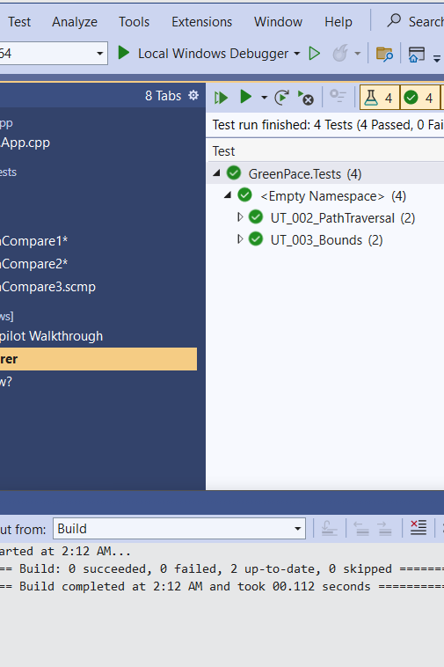
VISUAL STUDIOS RESULTS Unit Testing — Results (GoogleTest in Visual Studio)
In VS, open Test Explorer, run tests, keep only the tests pane visible.
Press Win + Shift + S → select the Test Explorer area with the green checks → save.
In PowerPoint: Insert → Pictures → This Device… → pick the screenshot.
Resize so the test names + green checks are readable.
(Optional) Insert → Shapes → Circle/
Coverage: UT_003_Bounds (within bounds, reject out-of-bounds), UT_002_PathTraversal (reject traversal & absolute paths).
Benefit: Prevents memory errors & directory traversal early in CI (fast feedback, lower risk).
Accessibility: Right-click the screenshot → View Alt Text → “Screenshot of Visual Studio Test Explorer showing four passing GoogleTest unit tests
Callout to highlight the green checks.
All unit tests passed (4/4) in ~1 ms using GoogleTest in Visual Studio.

Slide 10
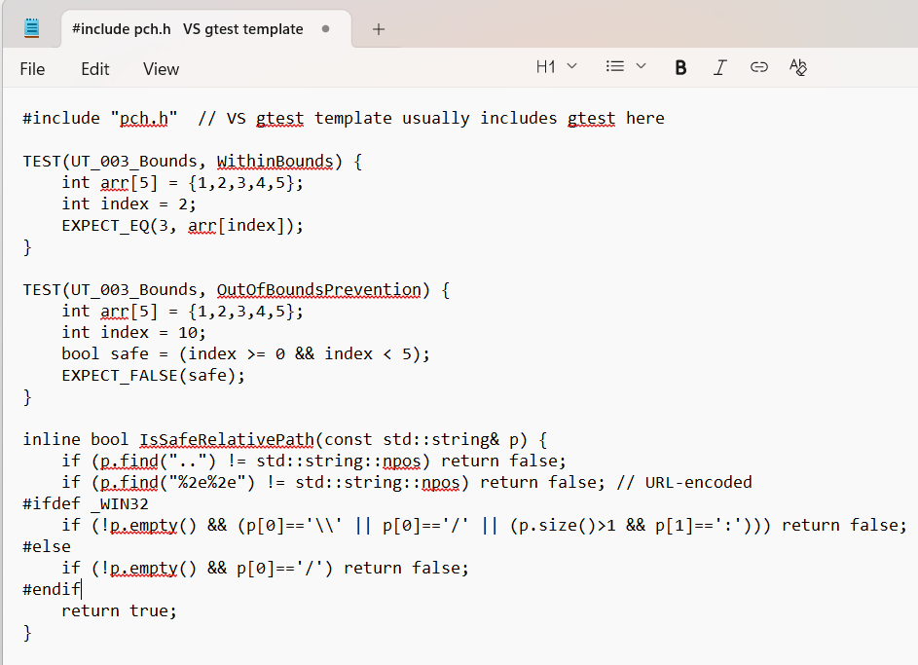
Example Unit Tests (gtest)
UT-003_Bounds: accepts valid index, rejects out-of-bounds.
Prevents memory safety bugs early, runs in <1ms.
Notes:
Here are two small GoogleTest cases for memory safety. The first test, WithinBounds, verifies a valid index returns the expected value. The second test, OutOfBoundsPrevention, asserts our guard logic catches invalid indices. These map to STD-006: Memory Safety, and they run in under a millisecond, making them ideal for CI gates.

Slide 11
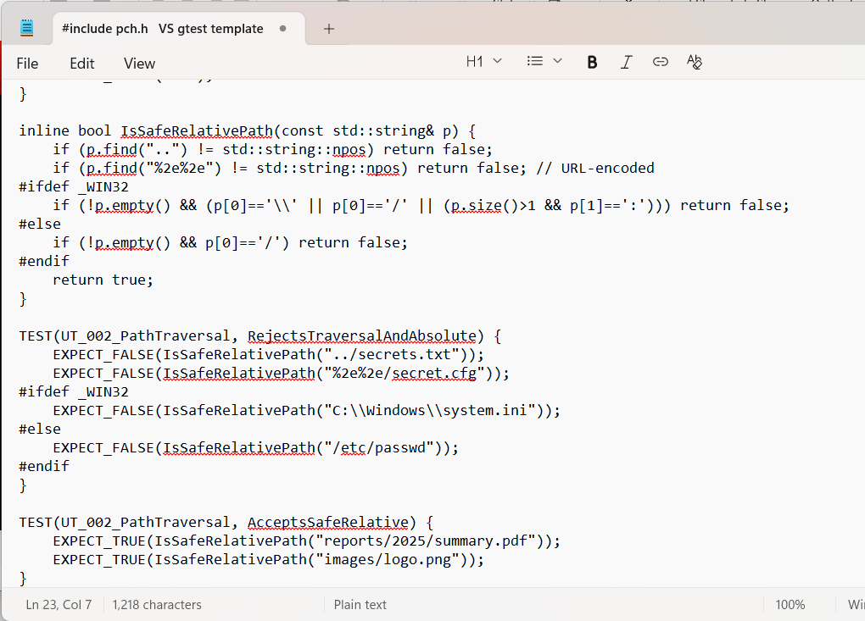
Example Unit Tests (gtest) cont…
UT-002_PathTraversal: rejects “..”, URL-encoded traversal, absolute paths.
Enforces safe relative paths; blocks directory-traversal attacks.
GoogleTest. (n.d.). Google Testing and Mocking Framework. https://github.com/google/googletest/
Microsoft. (n.d.). Google Test in Visual Studio (or “Test Explorer” docs).
Notes:
This pair focuses on path traversal. RejectsTraversalAndAbsolute fails for ‘..’, URL-encoded ‘%2e%2e’, and absolute paths like C:\... or /etc/.... AcceptsSafeRelative only allows safe project-relative paths. This maps to STD-001: Input Validation and blocks directory-traversal attacks before release.

Slide 12

AUTOMATION SUMMARY
Pre-commit: secrets scan (gitleaks), lint/format, unit tests (GoogleTest).
Build (compiler): /W4 /WX /sdl /guard:cf /Qspectre → treat warnings as errors; SAST (Cppcheck/Sonar).
Dependencies: SCA (Dependency-Check/Snyk) + SBOM (CycloneDX); pinned, signed sources.
Test & Staging: unit + boundary + fuzz (libFuzzer/AFL++), coverage; DAST with OWASP ZAP against QA.
Release: container & IaC scan (Trivy, Checkov); sign images/artifacts (Sigstore/cosign); store provenance (SLSA).
Runtime: central logs & alerts (SIEM), WAF/EDR, anomaly rules; auto-rollback & patch SLAs.
Gates: fail build on High/Critical; block deploy if DAST > Medium; publish reports as pipeline artifacts.
Notes:
Tools sit across pre-production → production to enforce standards:
STD-001/004 via SAST/DAST; STD-009 via SCA/SBOM; STD-008 via secret scans; STD-010 via hardening flags; STD-002/003/006 via tests & fuzzing.
The compiler is used at the build stage with security flags; any violation stops the line.
Evidence (SBOMs, scan results, signatures) is retained for audits and quick incident response.

Slide 13
TOOLS
DevSecOps flow: Plan/Design → Pre-commit → Build → Test → Stage/DAST → Release → Run/Monitor → Respond/Improve.
Pre-commit: gitleaks (secrets), clang-format/Prettier (style), GoogleTest (local unit tests).
Build (compiler): MSVC /W4 /WX /sdl /guard:cf /Qspectre; SAST with Cppcheck/SonarQube.
Dependencies: SCA (OWASP Dependency-Check/Snyk); SBOM (CycloneDX); pinned & signed sources.
Test: unit + boundary + fuzz (libFuzzer/AFL++); coverage (gcov/llvm-cov).
Stage (QA): DAST with OWASP ZAP against running app/APIs.
Release: container & IaC scans (Trivy, Checkov); sign images/artifacts (Sigstore/cosign); provenance (SLSA).
Runtime: central logs/SIEM (e.g., ELK/Splunk), WAF/EDR, anomaly alerts, auto-rollback & patch SLAs.
Gates & evidence: fail on High/Critical; block deploy if DAST > Medium; publish SBOM + scan reports + signatures.
Notes:
Tools enforce the standards: STD-001 (SAST/DAST), STD-008 (secrets scans), STD-009 (SCA/SBOM/signing), STD-010 (compiler hardening & release gates), STD-005 (logging/SIEM).
The compiler is used at the Build stage with security flags; any violation stops the line.

Slide 14
RISKS AND BENEFITS
Problems: Highest risks are STD-001 Injection, STD-008 Secrets management, STD-009 Supply chain, then STD-002/003/006 (auth/crypto/memory).
Act now — benefits: Shrinks attack surface; lowers breach likelihood/impact; speeds audits/compliance; creates repeatable, auditable CI gates; reduces long-term rework.
Act now — costs/risks: Short-term velocity dip; tool noise/false positives; added training and license costs. Mitigate: tune rules, phase rollouts, set “fail on High/Critical” only at first.
Wait — risks: Security debt grows; higher incident cost and downtime; secrets sprawl; supply-chain exposure; potential compliance findings.
Where strategy is thin: Legacy code coverage, runtime anomaly rules, chaos testing around auth/crypto failure, tabletops/IR runbooks, backup/restore drills, least-privilege reviews, clear metrics/KPIs.
Steps to take: Now (0–30d): lock down STD-001 & STD-008, enable secrets scan + SAST gates. Next (30–60d): add SCA/SBOM & signed builds (STD-009/010), ZAP DAST in QA. Later (60–90d): fuzz critical parsers, chaos tests, SIEM alert tuning, tabletop exercise.
Notes:
Acting now front-loads a small productivity hit but prevents expensive incidents later; we start with the highest risk items and only hard-fail on High/Critical to keep delivery moving.
Gaps focus areas: legacy components, incident readiness, and measurable outcomes (e.g., % repos with SBOM, mean time to remediate Highs, DAST pass rate).

Slide 15
RECOMMENDATIONS
Security Policy Gaps:
Missing policy for automated SBOM generation and enforcement.
No explicit rollback testing requirements.
Limited runtime anomaly response coverage.
Lack of documented thresholds for blocking builds based on vulnerability severity.
Recommendations:
Mandate signed SBOM for all releases.
Add rollback drills to release cycles.
Expand runtime monitoring to include behavioral anomaly detection.
Define vulnerability severity thresholds in CI/CD policy.

Slide 16
CONCLUSIONS
Standards to adopt to prevent future problems
OWASP ASVS L2 for web/APIs → maps to STD-001..005 (input validation, auth, crypto, errors, logging).
NIST SP 800-63B for authentication & session lifecycle (MFA, recovery, timeouts) → STD-002.
NIST SSDF + SLSA ≥ Level 2 for software supply chain; require SBOM (CycloneDX) and signed builds (Sigstore/cosign) → STD-009/010.
SEI CERT C/C++ rules + sanitizers (ASan/UBSan/TSan) for memory/concurrency safety → STD-006/007.
Crypto baseline: TLS 1.3, AES-GCM, approved libs; key mgmt per NIST 800-57 with KMS/HSM → STD-003.
CIS Benchmarks for OS/containers/cloud; IaC checks (Trivy/Checkov) → STD-010.
Logging & monitoring: central, immutable logs; alerting mapped to MITRE ATT&CK → STD-005.
Risk scoring: CVSS v4 + threat modeling (STRIDE) to drive fix priority and CI gates.
Bottom line: Formalize these standards in policy-as-code and CI/CD gates to keep Green Pace secure-by-default and audit-ready.

Slide 17
REFERENCES
National Institute of Standards and Technology. (2020). Security and privacy controls for information systems and organizations (SP 800-53 Rev. 5). https://doi.org/10.6028/NIST.SP.800-53r5
National Institute of Standards and Technology. (2023). Digital identity guidelines: Authentication and lifecycle management (SP 800-63B). https://doi.org/10.6028/NIST.SP.800-63b
National Institute of Standards and Technology. (2020). Recommendation for key management, part 1: General (SP 800-57 Pt.1 Rev. 5). https://doi.org/10.6028/NIST.SP.800-57pt1r5
OWASP Foundation. (2021). OWASP Top Ten Web Application Security Risks. https://owasp.org/www-project-top-ten/
OWASP Foundation. (2023). Application Security Verification Standard (ASVS) 4.0.3. https://owasp.org/www-project-application-security-verification-standard/
Software Engineering Institute, CERT. (2016). SEI CERT C Coding Standard. https://wiki.sei.cmu.edu/confluence/display/c/SEI+CERT+C+Coding+Standard
MITRE. (n.d.). Common Weakness Enumeration (CWE). https://cwe.mitre.org/
FIRST. (2023). Common Vulnerability Scoring System (CVSS) v4.0 specification. https://www.first.org/cvss/v4.0/specification-document
Microsoft. (n.d.). Security Development Lifecycle (SDL). https://www.microsoft.com/en-us/securityengineering/sdl
OpenSSF. (2023). SLSA Framework v1.0. https://slsa.dev/
CycloneDX. (n.d.). CycloneDX Software Bill of Materials (SBOM) specification. https://cyclonedx.org/specification/
OWASP ZAP. (n.d.). Zed Attack Proxy documentation. https://www.zaproxy.org/docs/
Google. (n.d.). GoogleTest user’s guide. https://google.github.io/googletest/
SonarSource. (n.d.). SonarQube user guide (SAST for C/C++). https://docs.sonarsource.com/sonarqube/
OWASP Foundation. (n.d.). Dependency-Check (SCA) user guide. https://jeremylong.github.io/DependencyCheck/

